Slide 1
ESN France
Thomas Joly – Vice-Président – vicepresident@ixesn.fr

Slide 2
Le Réseau en quelques chiffres

Slide 3
How many local sections do we have in France?

Slide 4
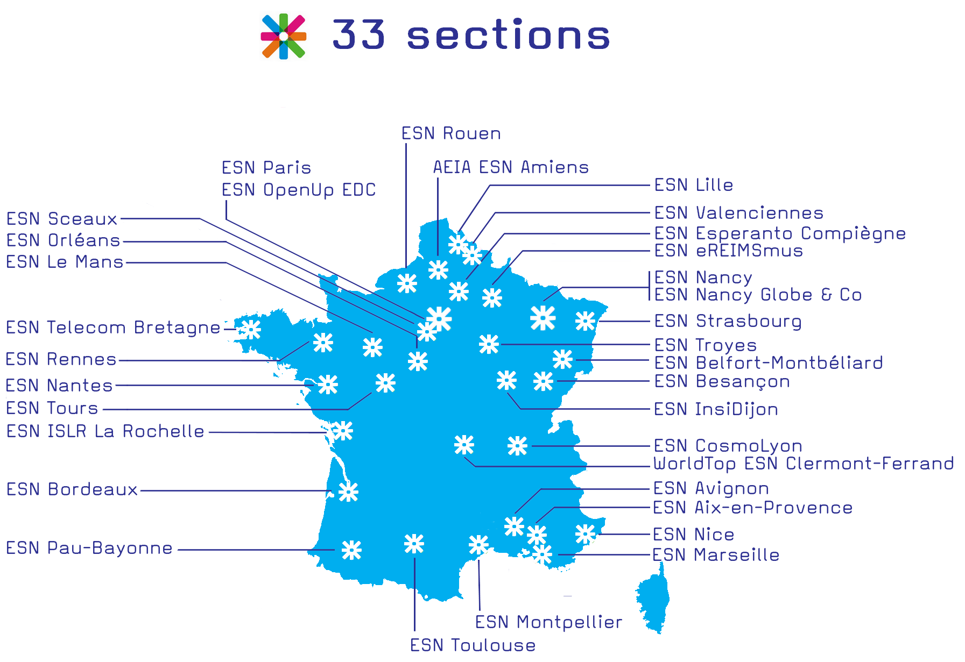

Slide 5
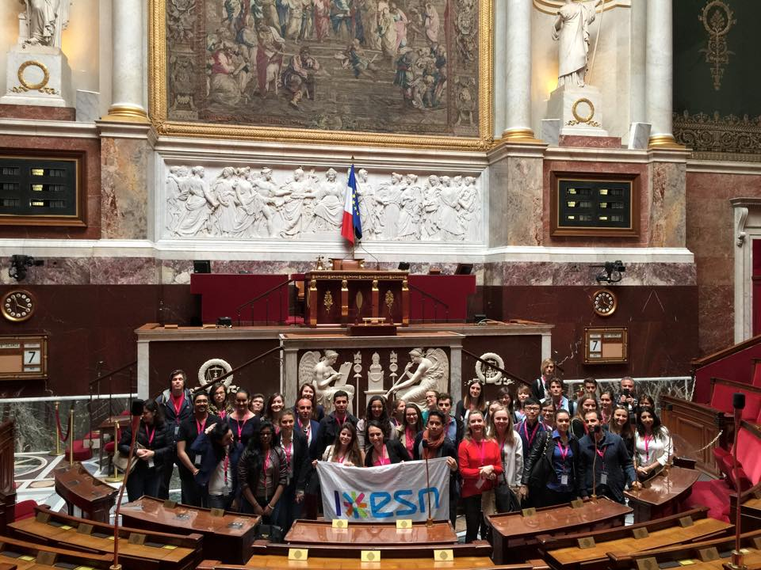
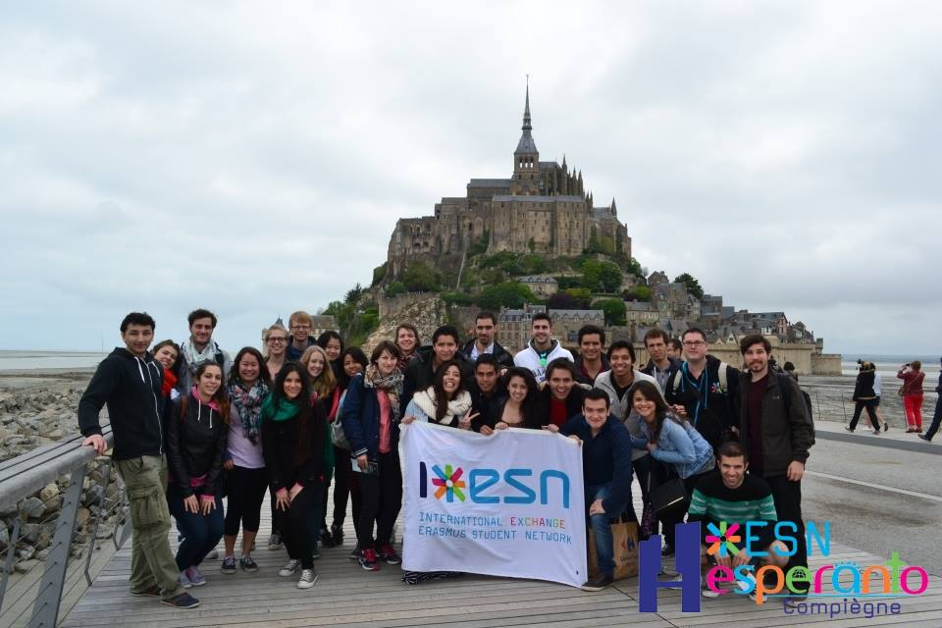
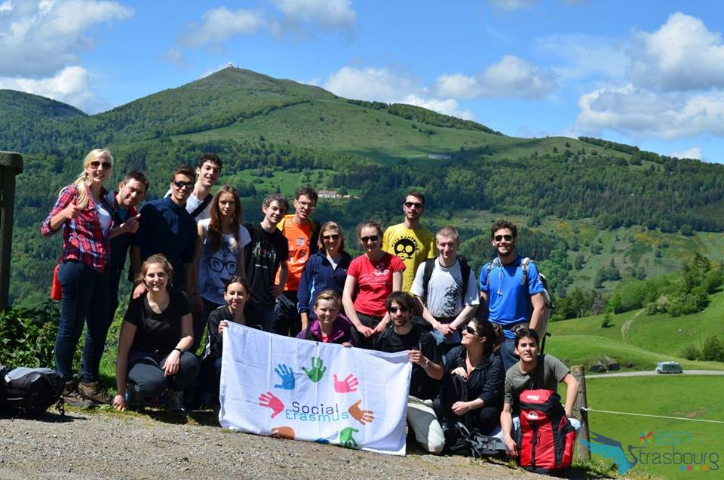
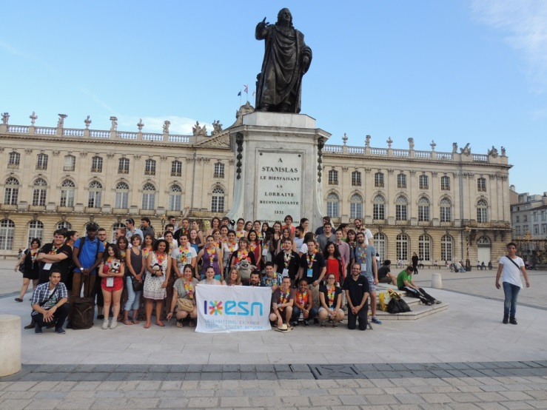
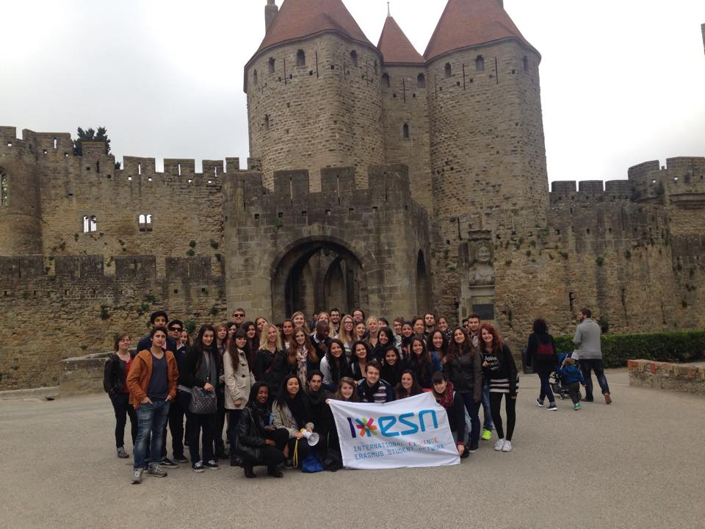
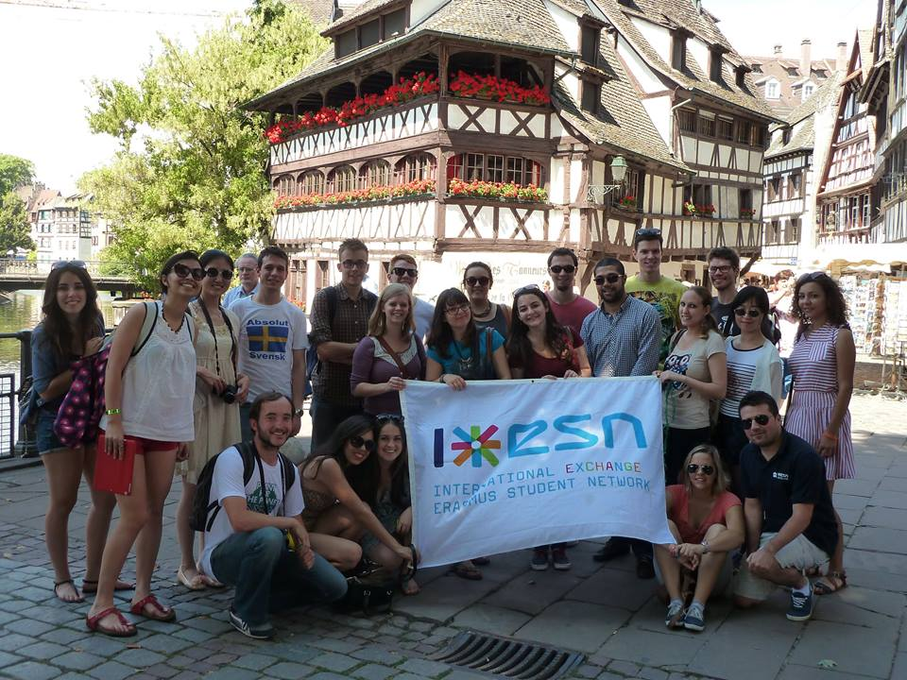

Slide 6
How many volunteers?

Slide 7
Volunteers:
More than 800 volunteers in 30 French Student Cities
We reach more than15 000 international students every year

Slide 9
Internal Organisation

Slide 10
Internal Organisation
1. The Administrative Council
2. The National Board
3. The Secretariat
4. The National Committees
5. The National Meetings
6. The Local Representatives

Slide 11
1. The Administrative Council

Slide 12
The Administrative Council:
17 members elected during the general assembly (in June)
7 National Board Members included
One-Year Term
5 meetings in person per year
Responsible for the ESN France Strategy (partnerships, communication, network, recruitment of the employees)
Control and support the National Board
Assist the employees and the Committees

Slide 13
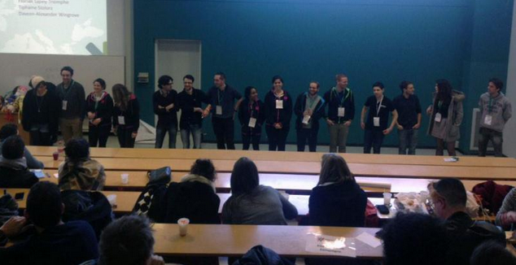
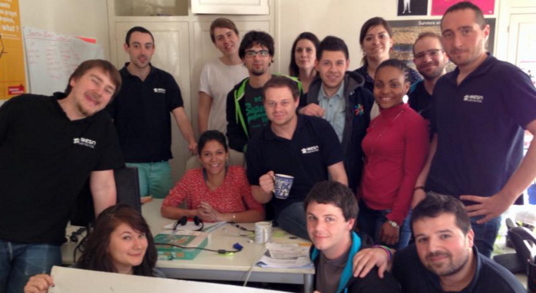
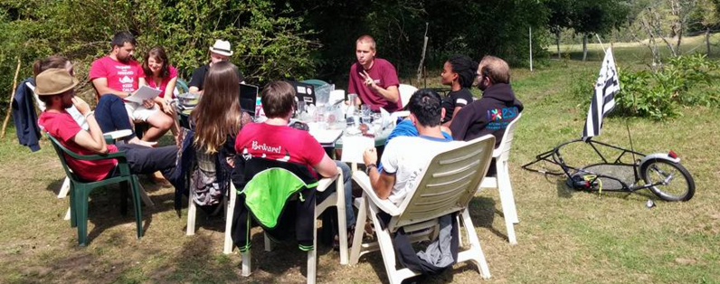

Slide 14
2. The National Board

Slide 15
The National Board

Slide 16
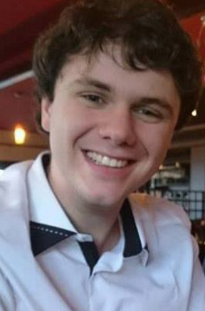

Slide 17
Yoan: Communication Manager
PR
Communication towards the partners
Social Networking
Website
Visual Identity
Communication Strategy

Slide 18
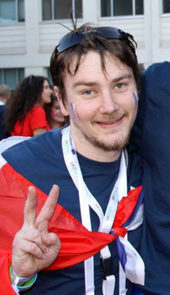

Slide 19
Rémi: Treasurer
Budget Management
Partnerships
ESNcards
Membership fees
Network Interaction
Financial Strategy

Slide 20
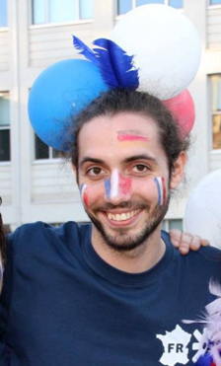

Slide 21
Corentin: National Representative
representative towards the int. network
Member of CNR
In charge of the delegates during each Int. event
Information Relay

Slide 22
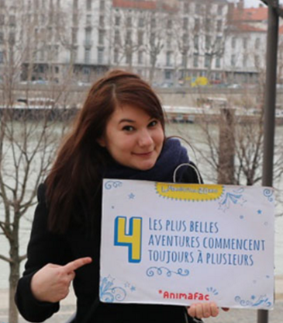

Slide 23
Orianne: President
NB and Administrative Council Management
Representant of ESN France towards the NA and public partners
ESN France global Strategy
Responsible of the Employees

Slide 24
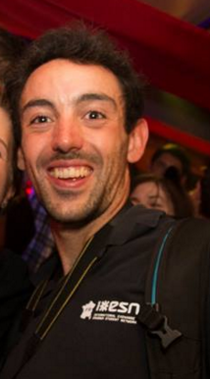

Slide 25
Steven: Secretary
Statutes and SO
Internal Communication
Minutes and agendas
National platforms
Archive

Slide 26
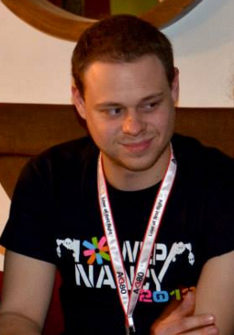

Slide 27
Maxime: wpa
Responsible of the Tools (maintenance and promotion)
IT Help for the sections
Website
Digital Strategy

Slide 28
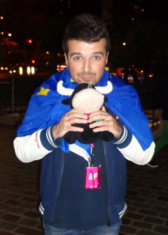

Slide 29
Thomas: Vice-President
Recruitment of the new sections
National Platforms
Network Care
Network Interaction
Events
Local Representatives

Slide 30
The National Board:
President
Vice-President
Communication Manager
treasurer
Secretary
National Representative (NR)
Web Project Administrator (WPA)

Slide 31
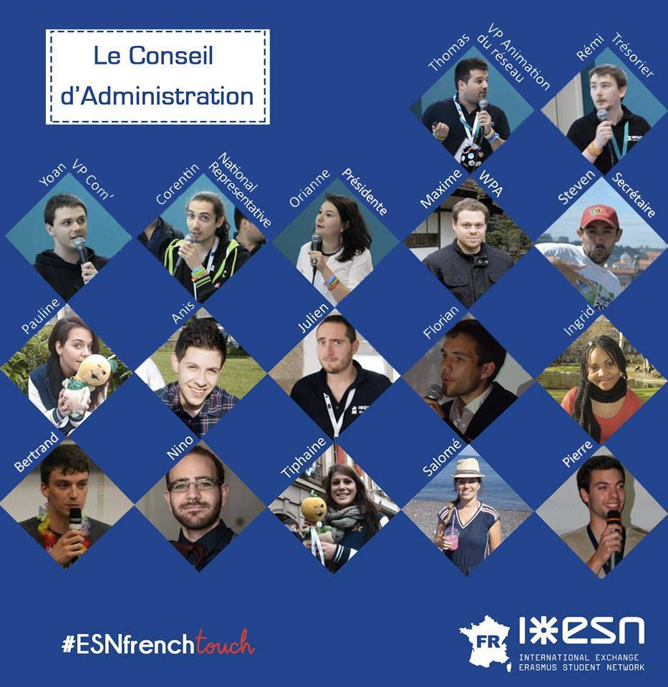

Slide 32
3. The secretariat

Slide 33
The Secretariat:
Premises shared with Animafac (rue de Dagorno, Paris)
2 full-time employees (Antoine + Sarah)
1 administrative assistant (Elodie)
3 voluntary services (Juliette + Adèle + Nicolas)

Slide 34
The Secretariat:
Support and help the NB, Administrative Council and committees
Coordination and monitoring of the national and international projects (ex: MappED)
Representative toward the institutional partners
Management of the National Budget
Better transition periods

Slide 35
4. The National Committees

Slide 36
The National Committees:
Research & Education (President)
Network (VP)
Communication (CM)
Treasury and Partnerships Management (treasurer)
International (NR)
G33k Team (WPA)
French & German Cooperation (NR)

Slide 37
5. The National Meetings

Slide 38
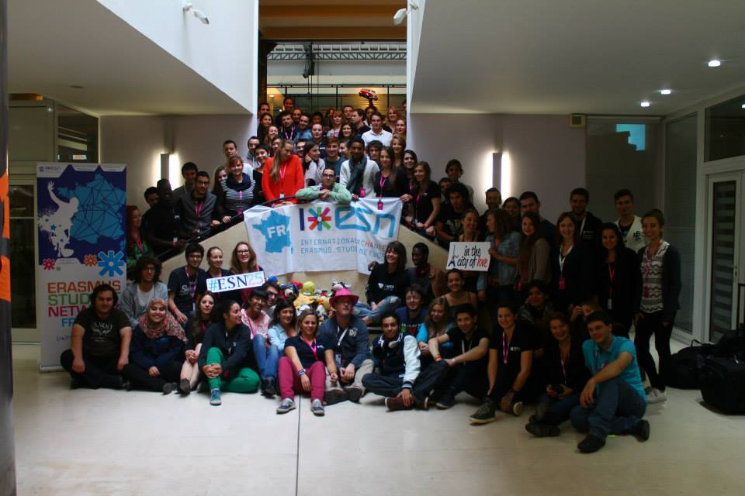
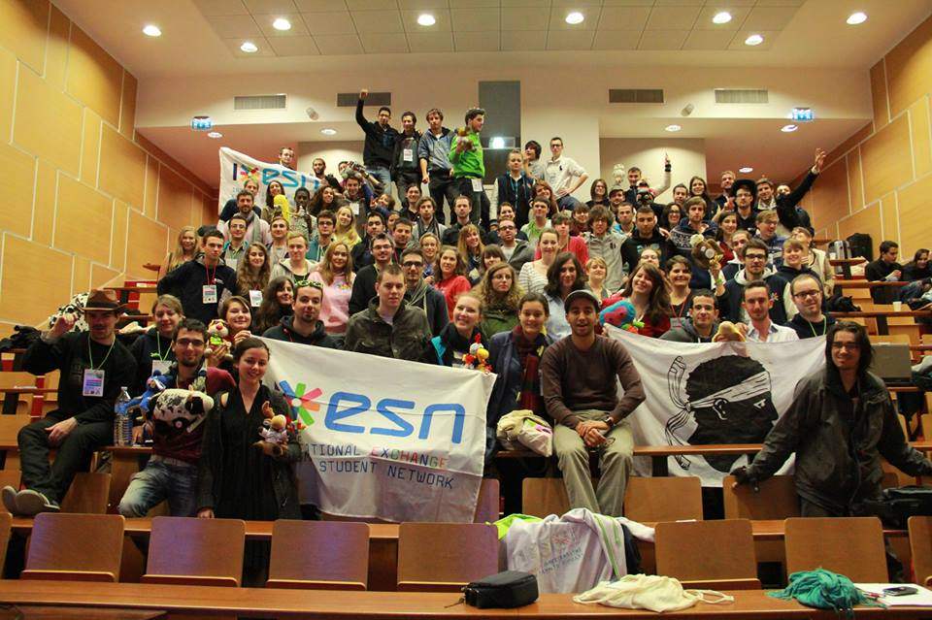
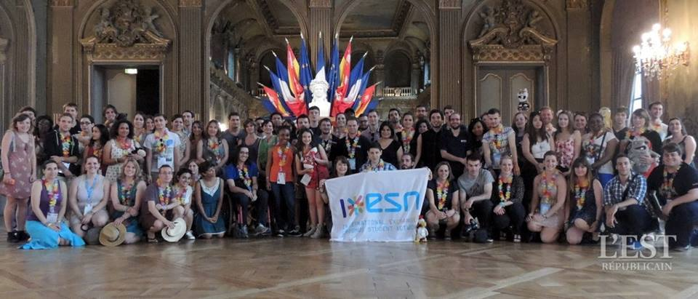
The National Platforms (NP):

Slide 39
The National Platforms (NP):
3 per year (October, February, June)
130 volunteers on average
Plenaries, Trainings, Small Sessions, Updates…
1 French Diner :p
1 General Assembly: statutes, SO, new board election
Recruitment of new sections (or candidate sections)

Slide 40
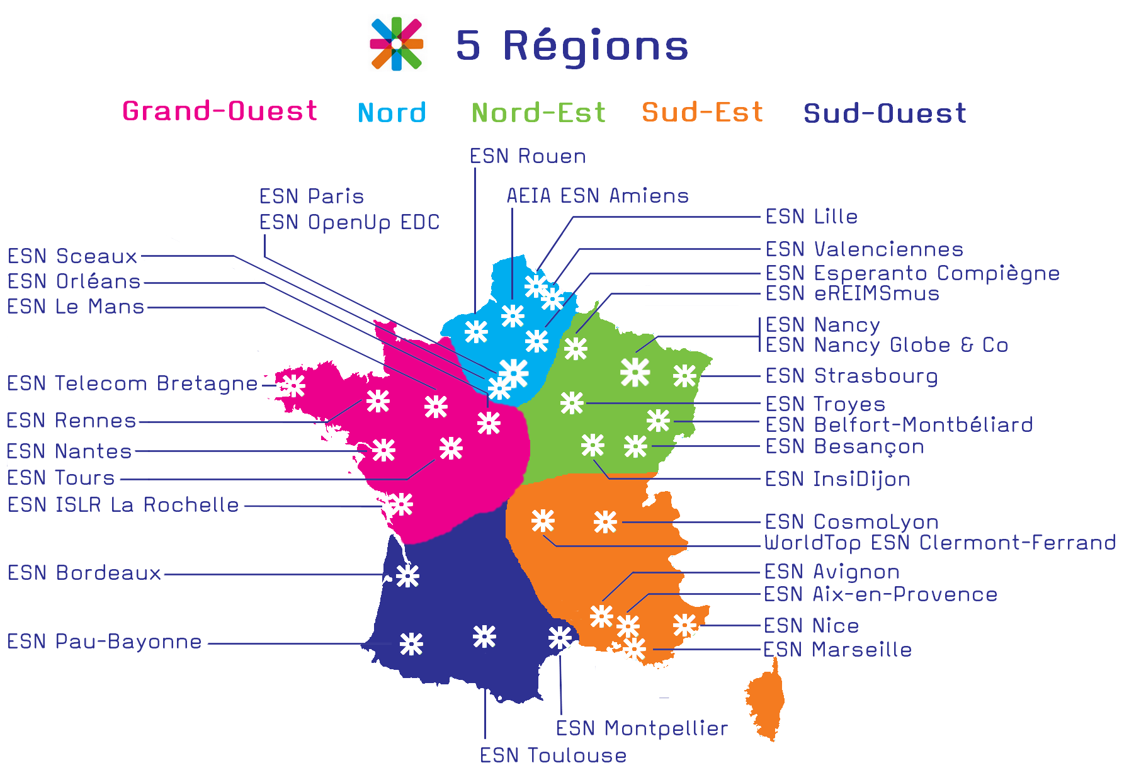
The Local Platforms (LP):

Slide 41
The Local Platforms (LP):
15/30 participants
Informal
One day only
Free Agenda (team building, trainings)
Stregthen the cooperation between sections from the same area
No more congestion during the NPs

Slide 42
The Trainings:
20/30 Participants
SocialErasmus, Mov’in Europe…
2 Times per year

Slide 43
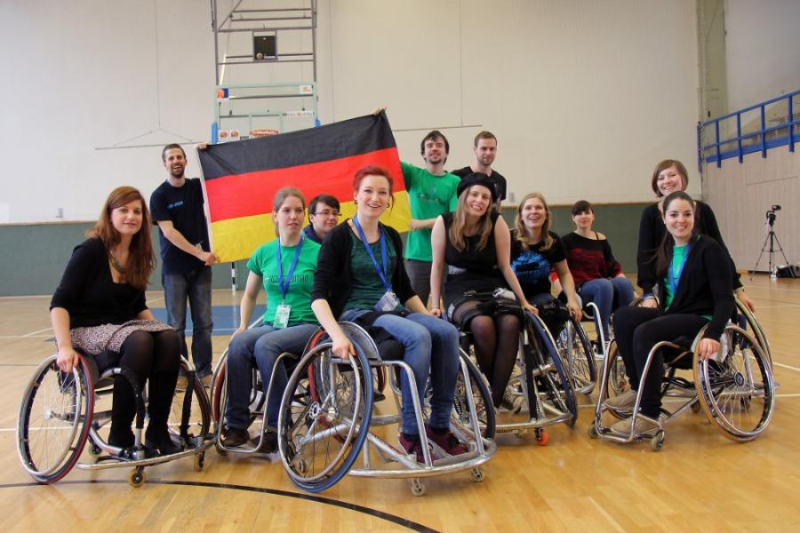
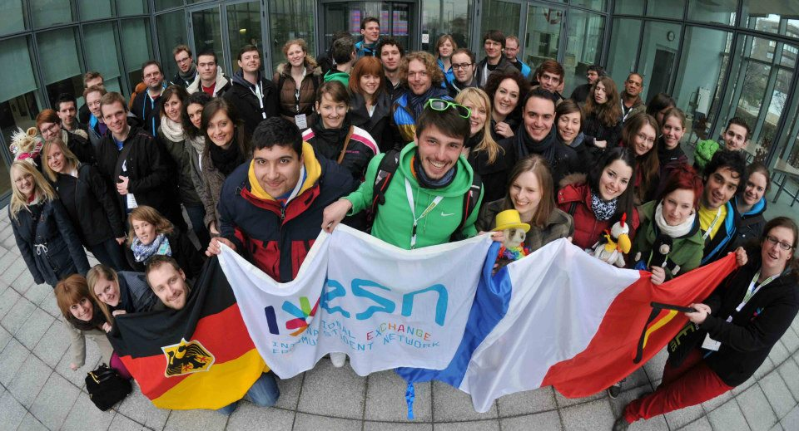
The French & German Section Meeting:
80/90 participants from France and Germany
Rotation system between France and Germany
Strengthen the links between buddy countries <3

Slide 44
6. The Local Representatives

Slide 45
The Local Representatives
Direct link between local, national and international levels
Responsible of the spots (priority order) during the national and international events
Information Relay
Mailing List, Skype Calls, Private FB Group, Own folder…

Slide 46
Our Projects & Tools

Slide 48
Tickets pour le monde Campaign:
20 000 passports printed
10 different kind of posters and postcards
1 website
1 NP allocated to the Campaign
NA + stakeholders support
3-years Campaign
Stickers, Tickets, Flyers…

Slide 49
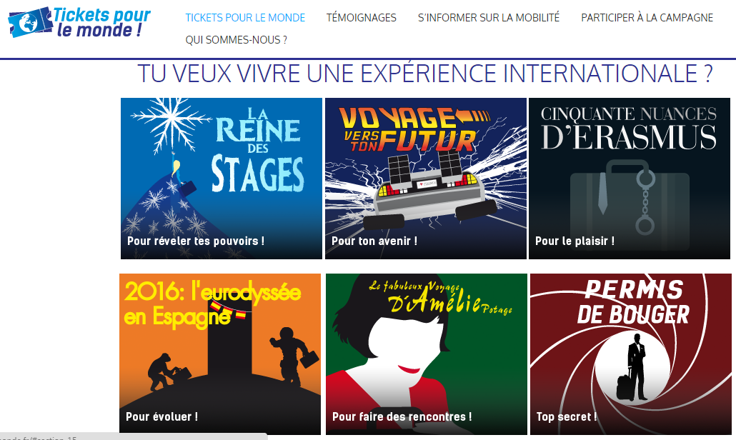

Slide 50
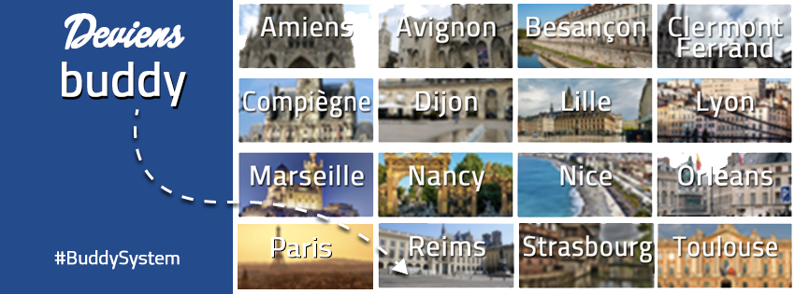

Slide 51
BuddySystem:
Launched by ESN Lille in 2013
Developped in more than 25 French cities
More than 5000 members this year
Great opportunity for Exchange Students
CROUS…

Slide 52
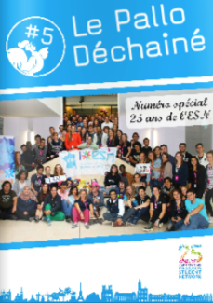

Slide 53
Pallo Déchaîné:
1st time published in 2012
More than 15 magazines so far
400 monthly readers on average
16/20 pages
Cooperation between 2 national committees

Slide 54
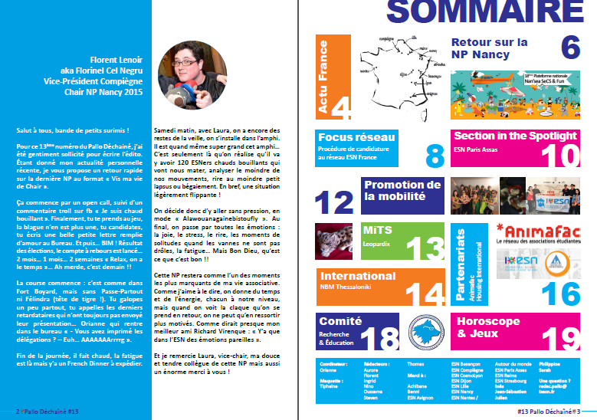

Slide 55
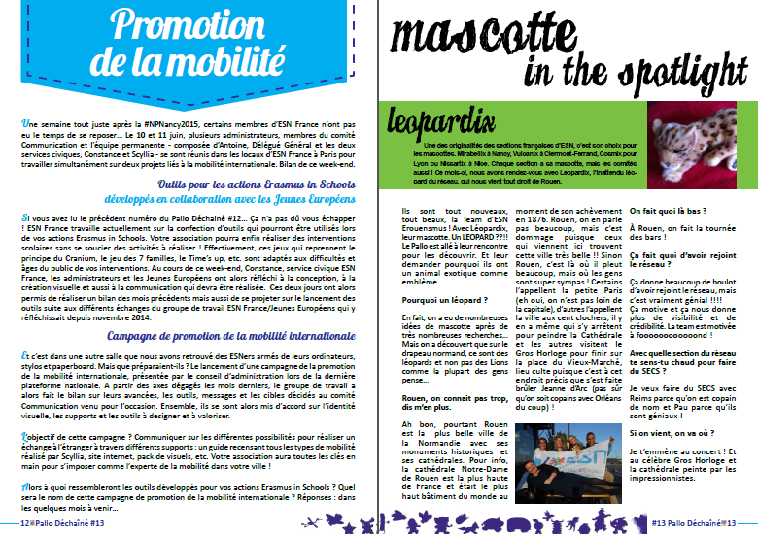

Slide 56
Nuit des étudiants du Monde (NEM):
Initiated by the City Council of Lyon 12 years ago
Cooperation entre AVUF et ESN
Take place in October
More than 20 French cities
The aim is to take care of the International Students, integrate them and provide them with one special evening

Slide 57
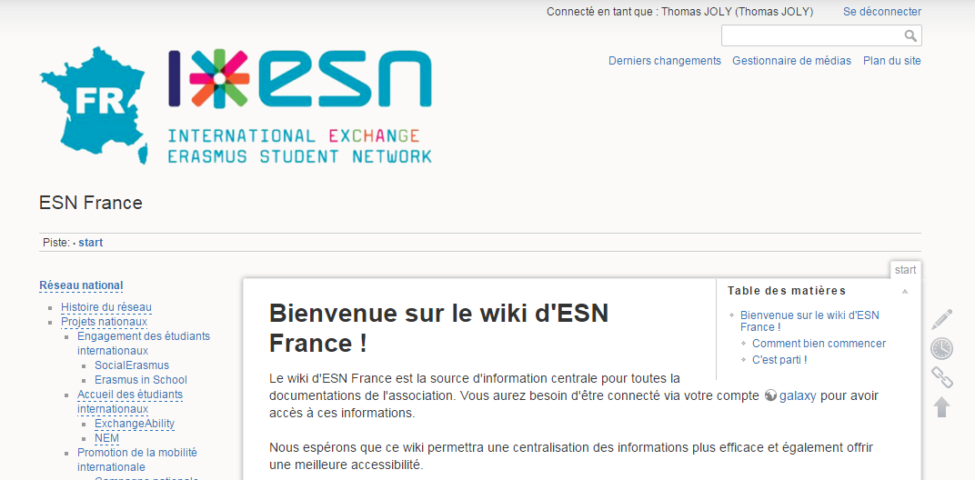
Wiki ESN France

Slide 58
Module bénévole

Slide 59
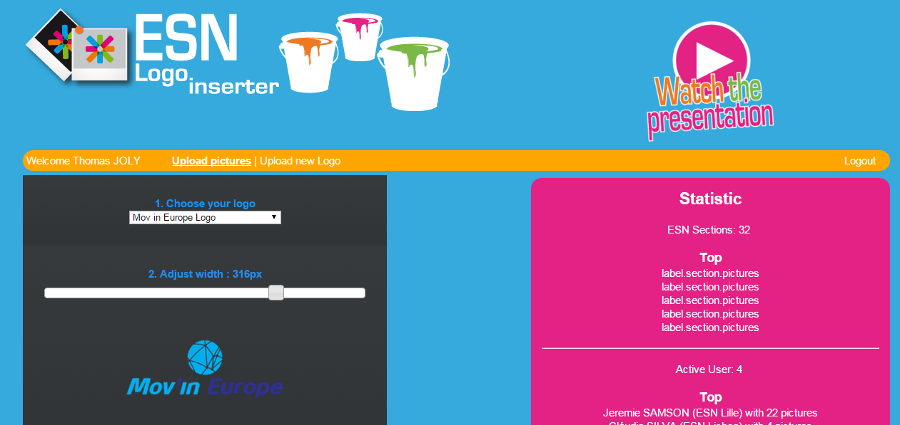
Logo Inserter:

Slide 60
Section in the Spotlight
1 online form
1 election per month (Network Committee + ComCom)
Valorise the work of one section

Slide 61
Bientôt dans vos assos:
Webshop
Annuaire ESN France
Surveys
Kit rentrée pour vos bénévoles
Encore + de BuddySystem, Wiki, NEM, etc.

Slide 62
Our Partners & Stakeholders

Slide 63
Other organisations:

Slide 64
Institutional partners:

Slide 65
Corporate & Strategic Partners:

Slide 66
Contacts

Slide 67
IxESN France 23, rue de Dagorno 75012 Paris FRANCE Tel. +33 9 73 87 17 86 contact@ixesn.fr bureau@ixesn.fr
HTTP://IxESN.FR
Facebook.com/IxESN
@IxESN
More and more on…. Our Wiki!
http://wiki.ixesn.fr/

Slide 68
How to fill the gaps between local, national & International levels?

