Slide 1
Kosmo’Poitou
Cassandre DAUGER, Roger NAOUFAL

Slide 2
Welcome to Poitiers!!
A small, well placed city:
Close to the ocean
Between bordeaux and Paris
Easily accessible by the TGV
1h40 from Paris
A « University » city:
1 over 4 inhabitants is a student
A good quality life

Slide 3
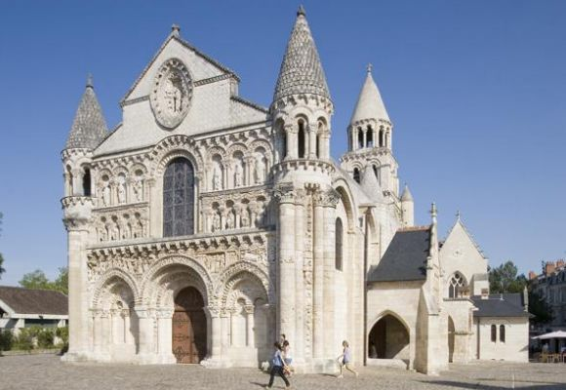
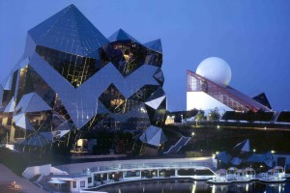
Culturally speaking
A city where the history stamp is noticeable everywhere!
A very well known city for the Futuroscope
Numerous festivals: Expressifs, Cinema festival, etc

Slide 4
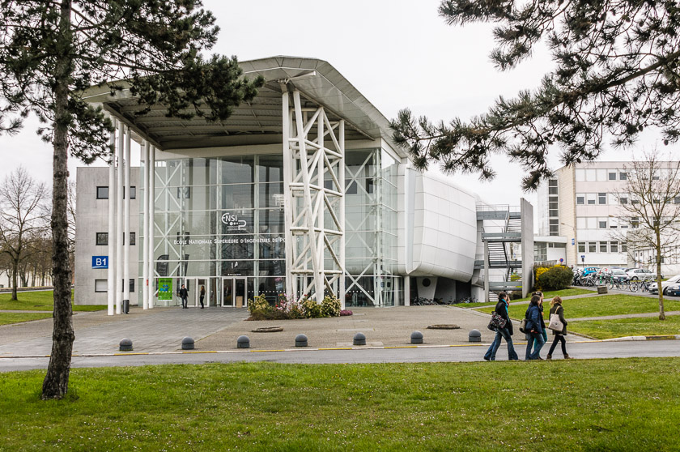
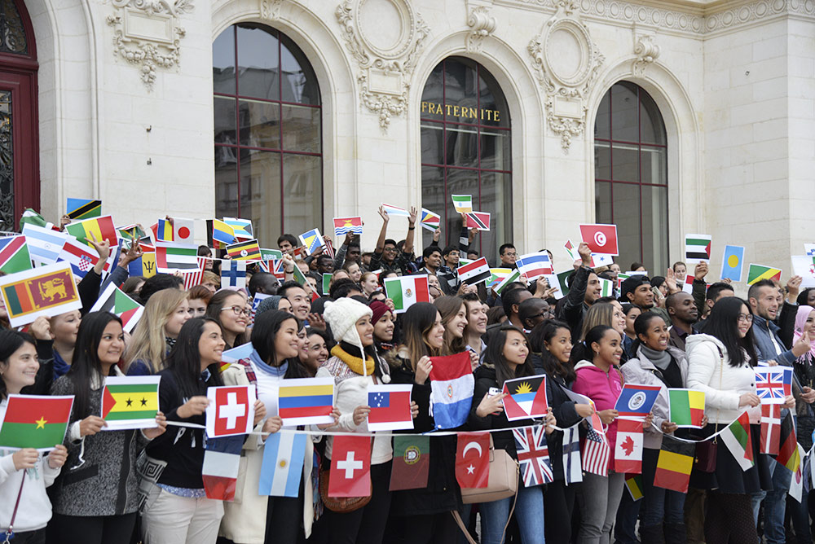
Our university!
From the DUT to the thesis.
Over 270 university partnerships all over the world.
A Very large variety of diplomas.
4000 foreign students every year!

Slide 5
How we take care of our foreign students
Help from the Crous finding a place to live in (Dormitory, private appartements)
French lessons
Welcoming the foreign students by the town hall of Poitiers.
Local families greeting of the foreign students.

Slide 6
Kosmo’Poitou!
IAE project (Professionnal, Structured, Monitored)
5 students (Comitee members) – 3 recent volunteers
Our motivations?

Slide 7
Our short term objectives
Communicate on the association → social medias
Create a website
Making sure to have the university’s financial support
Ensure a solid bases for next year’s sustainability/ Proper functioning
Get prepared to greet next year’s foreign students

Slide 8
Activities!
First and foremost: greeting and gathering the students
Gathering activities: organised parties in bars and night clubs, picnic, etc
Second step: making them live an amazing experience :
Cultural activities:
Futuroscope
Les géants du ciel
L’île au serpent
International quizz
Intellectual activities

Slide 9
Sports activities
Paintball
Iceskating
Football
Llazergame
Events:
Organized party
Theme party
Tandem
Weekend Trips
National Trips

Slide 10
Conclusion
A big multicultural family!
An better international attractiveness

Slide 11
Thank you for your invitation!

