Slide 1
ESN Czech Republic
Czech us out!

Slide 3
So you want to know more about us?

Slide 4
ESN Czech Republic
Founded in 1999
First sections: ISC CTU in Prague & ESN VSE Prague
2002 – ESN Czech Republic
2004 – 1st National Board
2007 – legal organisation
7000 international students every year
Supported by National Agency, National Youth Council, National Student Union and European Commission Representation in the Czech Republic

Slide 5
Sections
18
5 x Prague
3 x Brno
2 x Ostrava
Olomouc
Zlín
České Budějovice
Pilsen
Ústí
Liberec
Hradec Králové
Pardubice

Slide 6
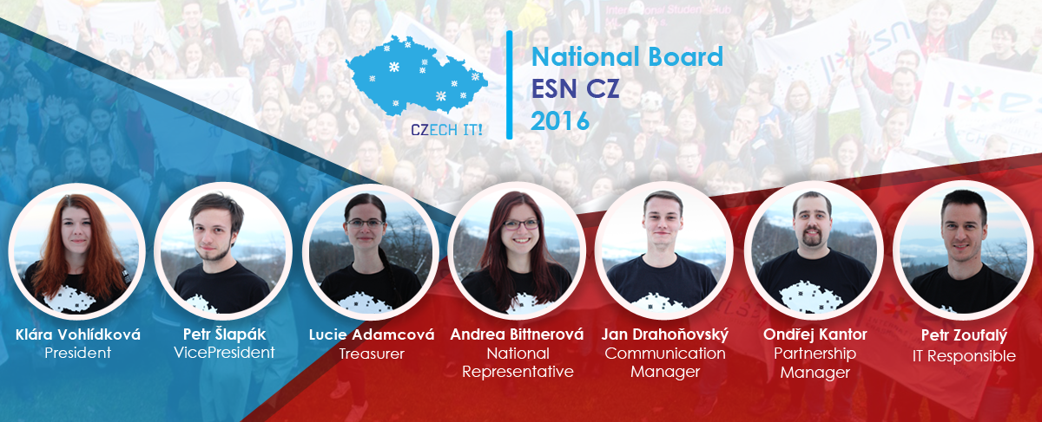
National Board 2016

Slide 7
National Board is supported by…
NB Supporters
National ExchangeAbility Coordinator – Barbora Rusínová
National SocialErasmus Coordinator – Jiří Beran
PR Team – Jaroslav Moucha, Klára Kišová, Eva Machová
Events Manager – Martin Zapletal
Education Officer – Mikuláš Josek
Legal Supporter – Roman Dostál
NR supporter – Zdeněk Hanzal
Workshop Coordinator – Monika Lazarová
FR coordinator – Petr Staníček
Project Manager – Kateřina Kadlecová
Alumni Coordinator – Nikola Pavlová
Advisory Board
3 members (usually former NB) who advise NB with their work
Vladimír Sák, Jiří Brom

Slide 8
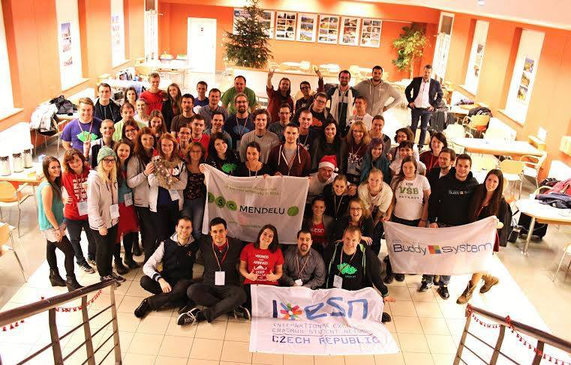
National Platforms
2 x big NP (April, November)
4 x small NP (CLR – February, June, September, December)
Small NPs
1 day
Procedural
1-2 members per section,
NB, NB supporters, AB

Slide 9
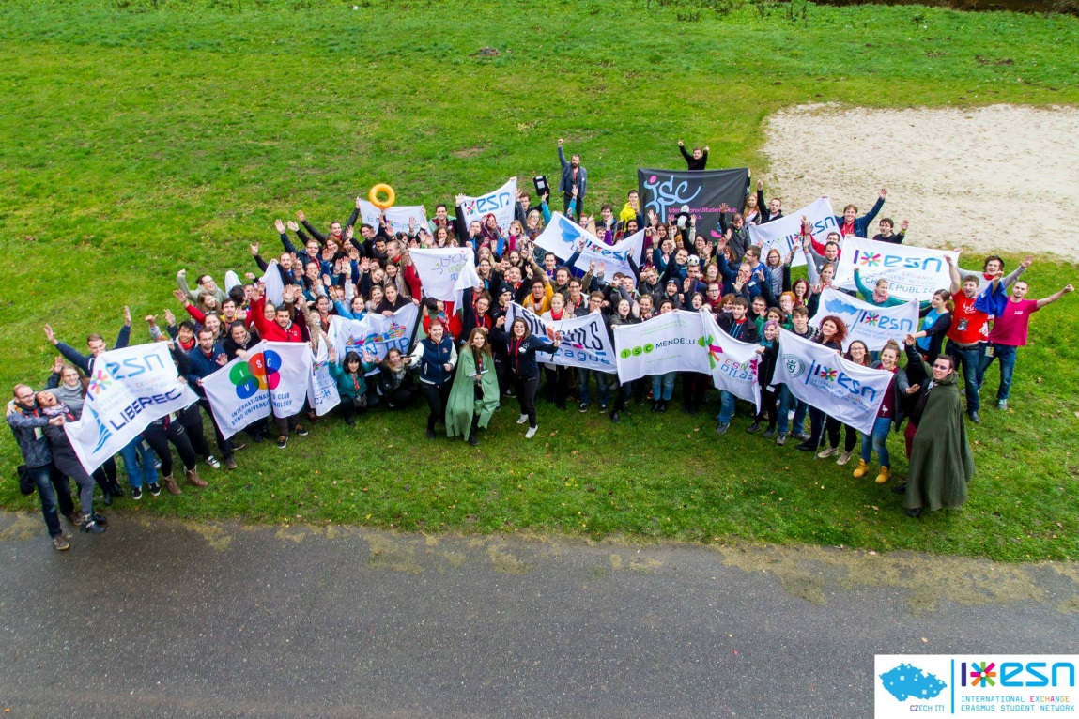
National Platforms
Big NPs
3 days (plenaries, workshops, small sessions, meet your colleagues,
themed games)
Networking, informal
Election of NB
(November)
160 participants on
average (around 5 per
section, NB, NB
supporters, AB,
foreign guests)

Slide 10
Next National Platform: NP Lipno, April 15-17

Slide 11
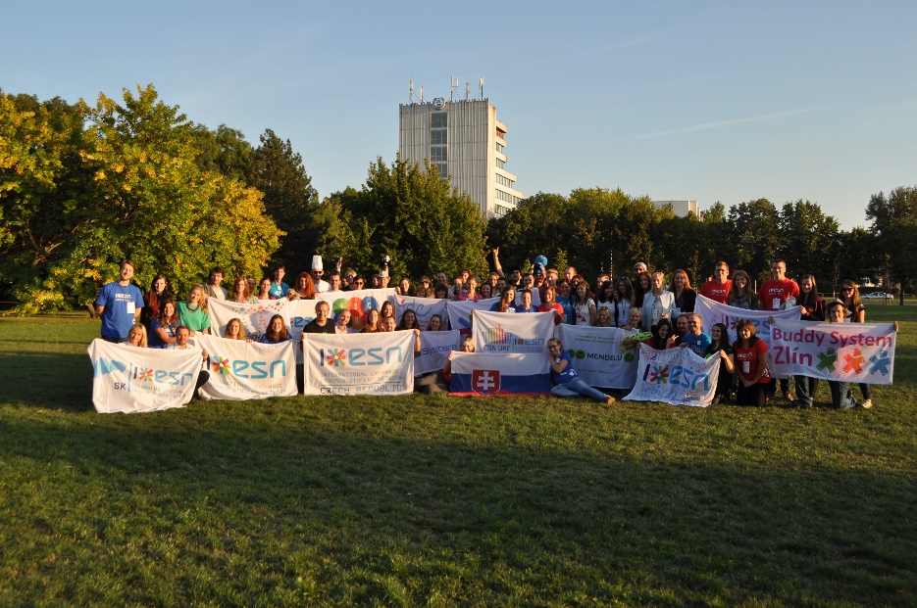
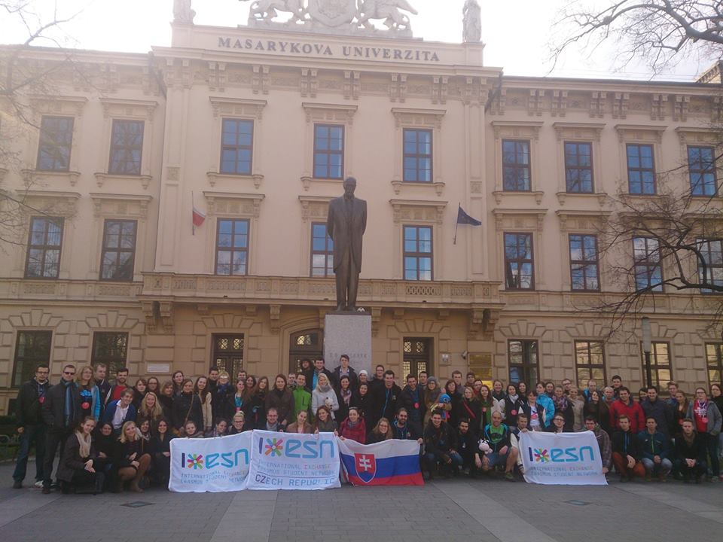
NP Czechoslovakia
Joint National Platform
1 x a year
Separate plenaries, joint workshops and small sessions

Slide 12
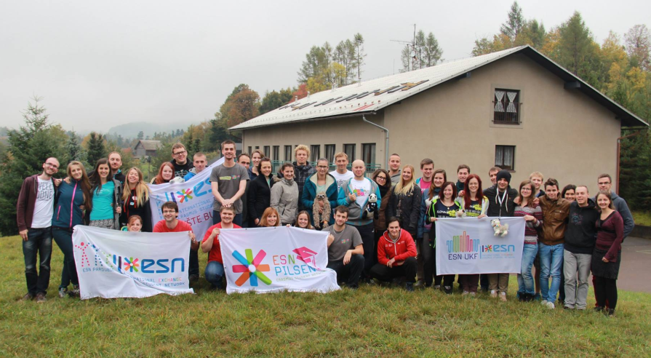
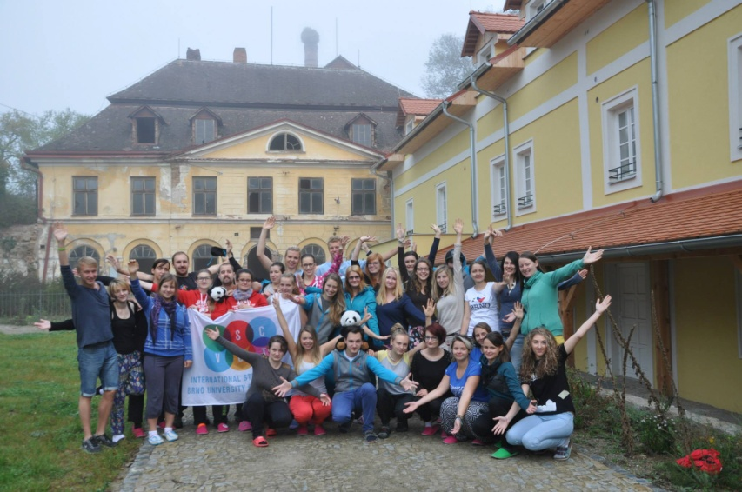
TRAIN IT!
National Training Event
Non-formal education
2x a year
1st Czech-Slovak version autumn 2015

Slide 13
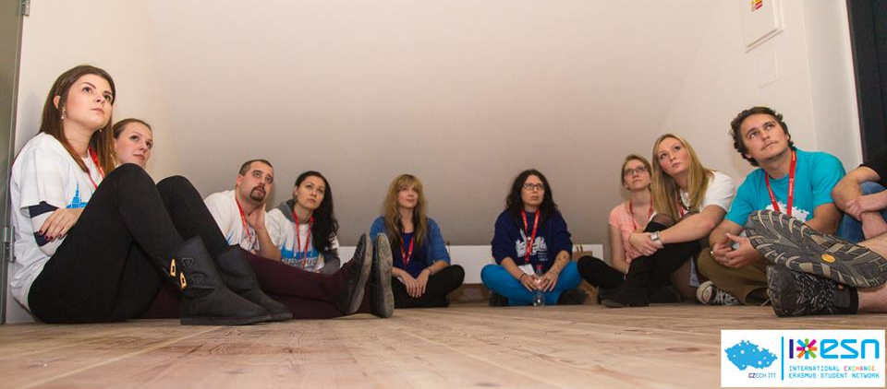
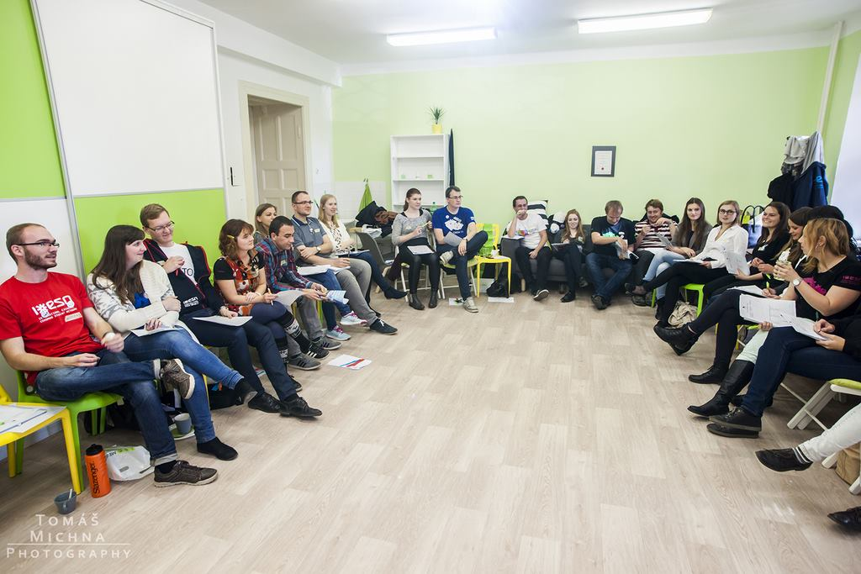
Meet Your Colleagues Meetings
Position meetings for 1-2 days/semester:
Presidents & Vicepresidents
Treasurers
FR United
PR Responsibles
IT Responsibles
Activity Coordinators
International infomeeting
SocialErasmus Coordinators
ExchangeAbility Coordinators

Slide 14
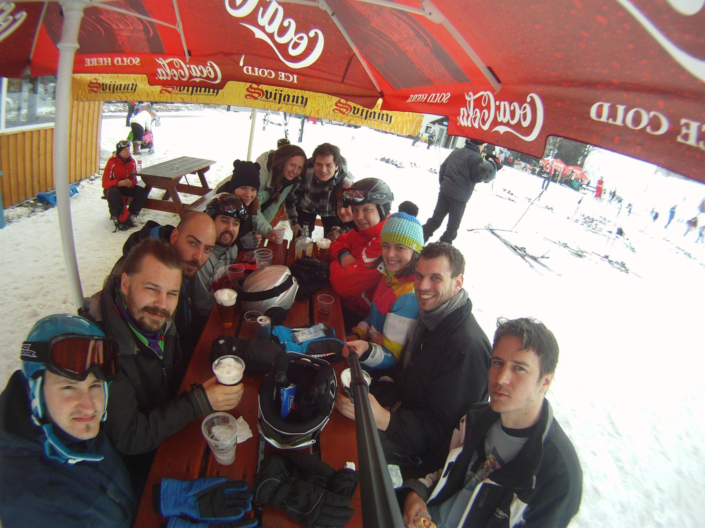
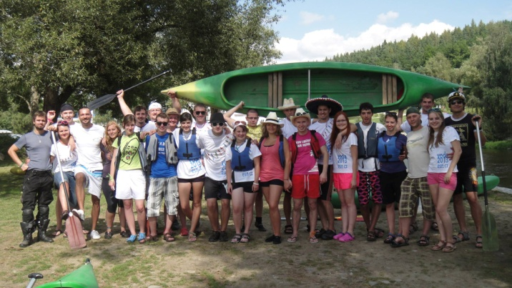
Teambuilding of ESN CZ
ESNow
ESN Voda

Slide 15
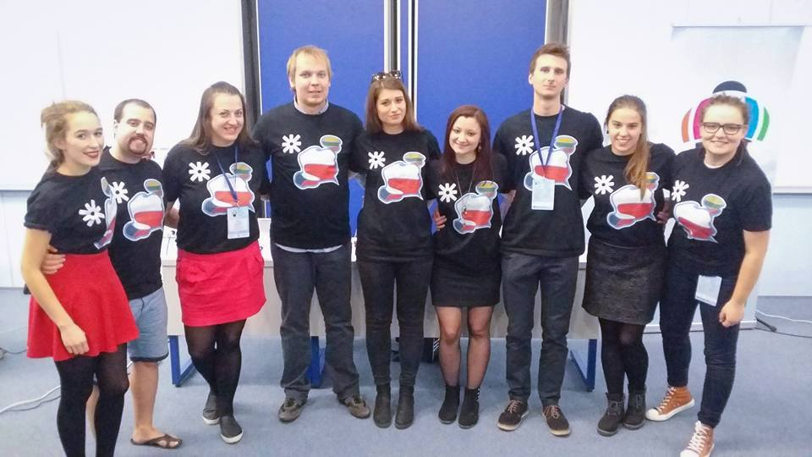
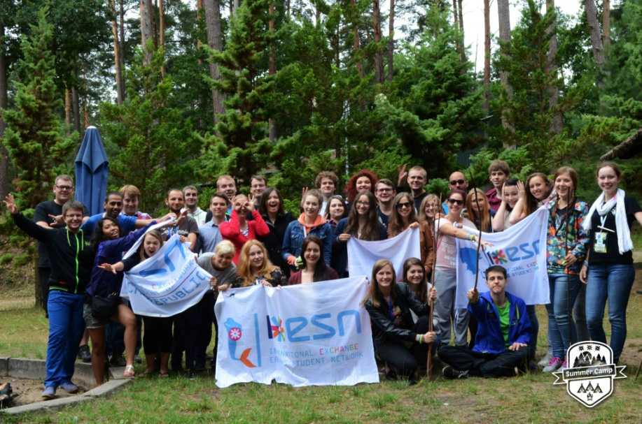
Poland+Lithuania cooperation

Slide 16
International Committees
International Committee of Education (ICE)
ESN CZ: Andrea Bittnerová, Jan Lukačevič
Network Committee (NEC)
ESN CZ: Martin Zeman
Finance Committee (FiCo)
ESN CZ: Petr Staníček, Karolína Janatková
Communication Committee (ComCom)
ESN CZ: Jan Hrubý, Pavlína Koščová, Tereza Vlasáková
IT Committee (ITcom)
ESN CZ: Václav Rozsypálek, Petr Zoufalý, Adam Farnik

Slide 17
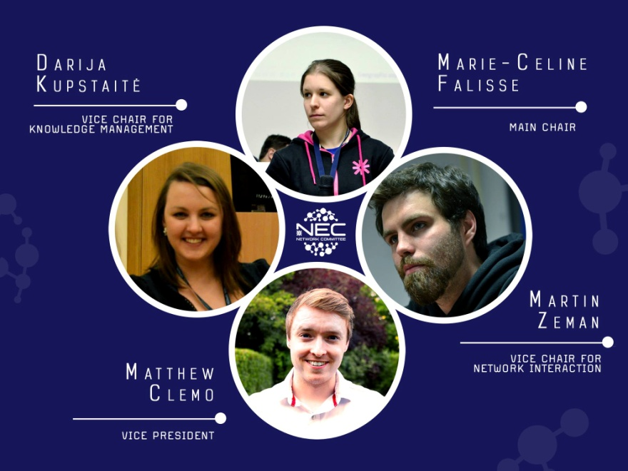
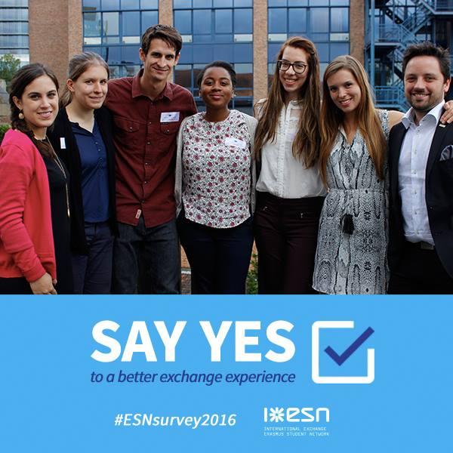
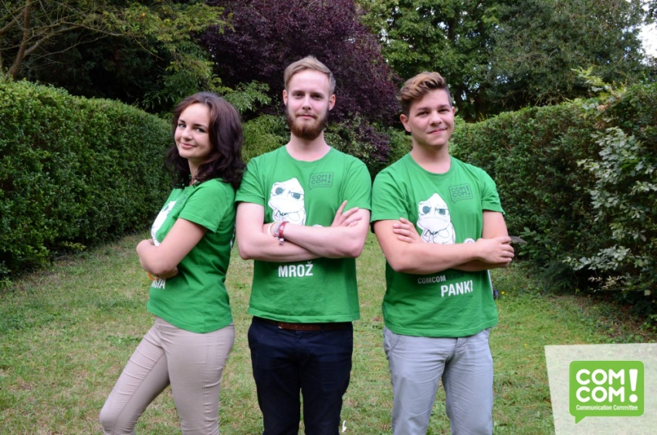
International level of ESN
Notes:
Mikuláš je ESNsurvey koordinátor, Martin Zeman vice-chair Nec, Mrož chair ComCom

Slide 18
ESN International events
Notes:
Eventy konané v roce 2015

Slide 19
Interesting facts

Slide 20
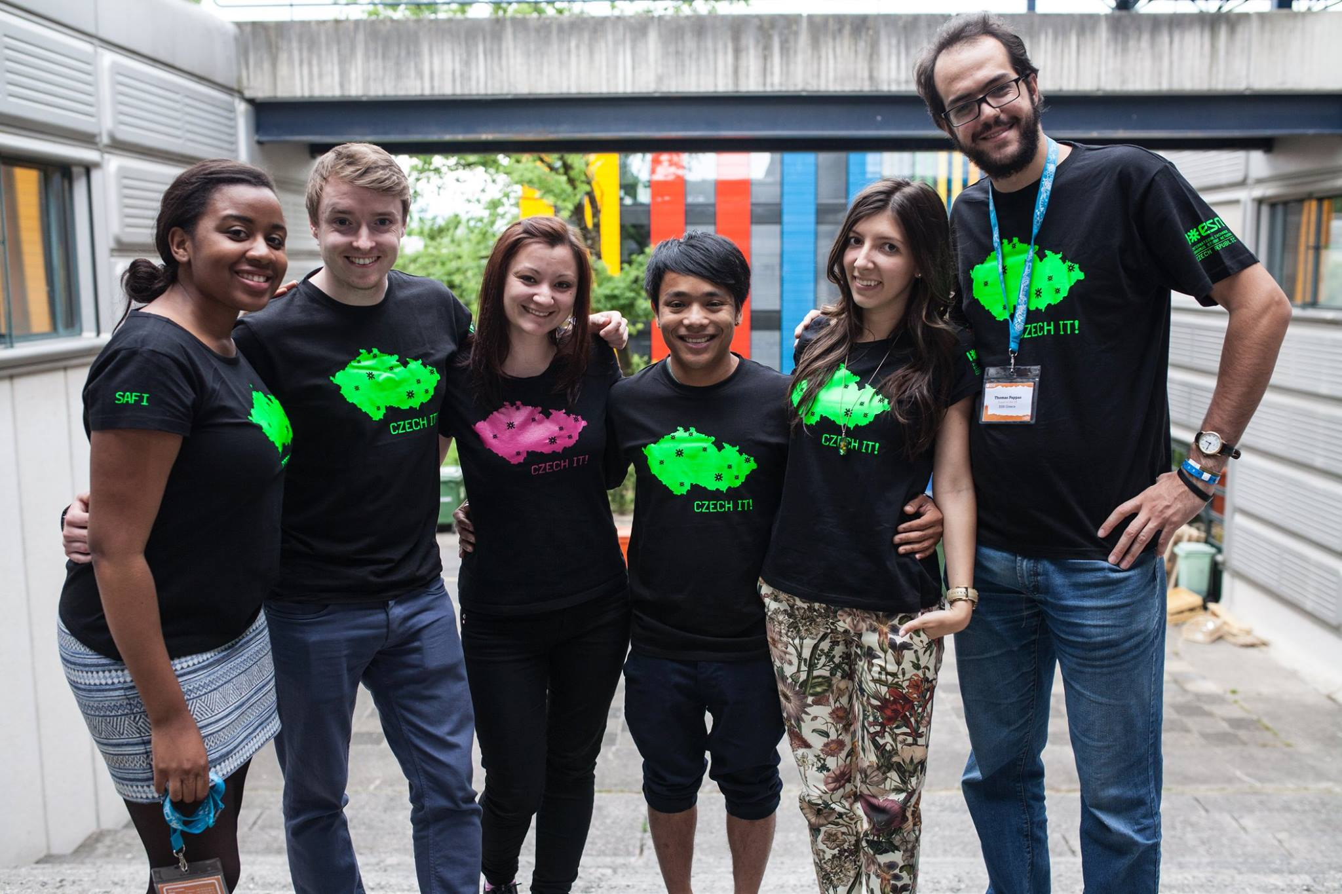
Czech IT!
The unique and strong brand

Slide 21
Partners
BoHo – hostels in Prague
15% discount for students with ESNcard, family of students, students without ESNcard (before semester)
Eurolines – bus company providing services all across the Europe
20% discount for students with a unique code
25% discount for groups (10 and more students)
Individual discounts for our trips
Vodafone – mobile operator – a special offer for ESN
Freshlabels, Prague Chocolate, ...
Notes:
Můžou využít taky oni – SleepwithESN na BoHo, TourwithESN na Eurolines

Slide 22
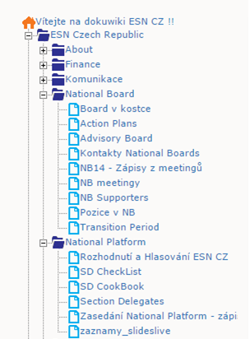
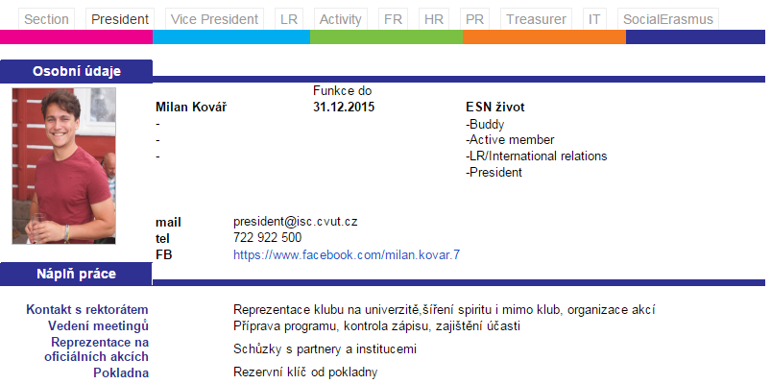
ESN DokuWiki
Knowledge Management tool of ESN CZ
Statutes & Standing orders of ESN CZ
Minutes from NPs and NB meetings
Section information
Basic information
Board members profiles

Slide 23
socialerasmus@esn-cz.cz
NSEC| ESN Czech Republic
LSEC| ESN UP Olomouc
/esncz
@esn_cz

