Slide 1
ESN UK Publications Update
Madalina Cretu – madalina.cretu93@gmail.com

Slide 2
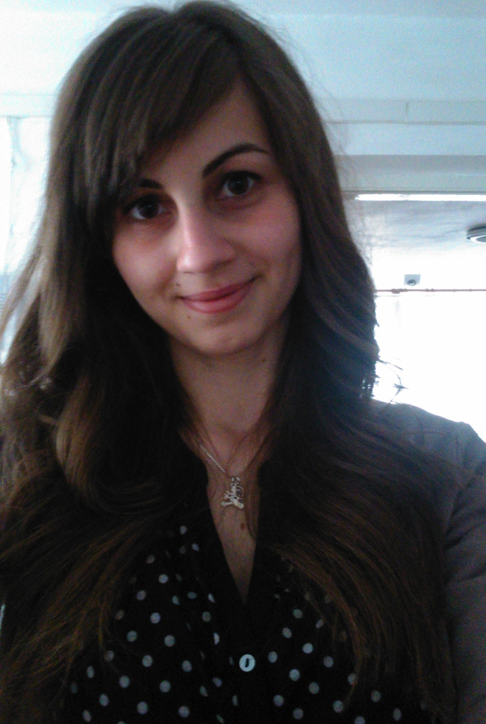
Who am I? -Madalina Cretu (Maddy) -22 years old => Erasmus+ -Former ESN UK Publications Specialist

Slide 3
Publications Specialist Position: -ESN UK’s Newsletter. -Represent and promote ESN UK at official events. -Update the Press Room. -Recruit potential writers. -Local level – new writing projects.

Slide 4
Local Project: ESN Southampton Erasmus+ Blog -Articles written by Erasmus+ students. -Active participation from Erasmus students. -Mobility promoted to home students. -Website traffic increased.

Slide 5
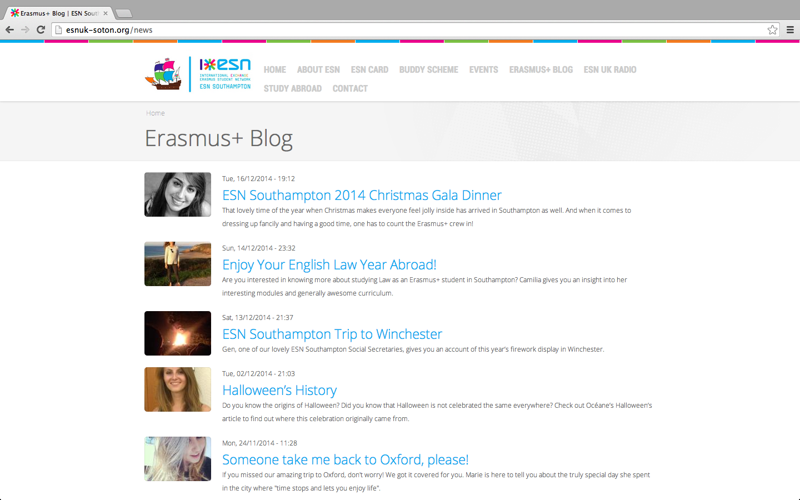

Slide 6
Thank you for your attention!

